Slide 1
Inheritance, Polymorphism, and Interfaces
Chapter 8

Slide 2
Objectives
Describe polymorphism and inheritance in general
Define interfaces to specify methods
Describe dynamic binding
Define and use derived classes in Java
Understand event-driven programming in JavaFX

Slide 3
Inheritance Basics: Outline
Derived Classes
Overriding Method Definitions
Overriding Versus Overloading
The final Modifier
Private Instance Variables and Private Methods of a Base Class
UML Inheritance Diagrams

Slide 4
Inheritance Basics
Inheritance is a form of software reuse in which a new class is created by absorbing an existing class’s members and embellishing them with new or modified capabilities.
Inheritance allows programmer to define a general class
Later you define a more specific class
Adds new details to general definition
New class inherits all properties of initial, general class

Slide 5
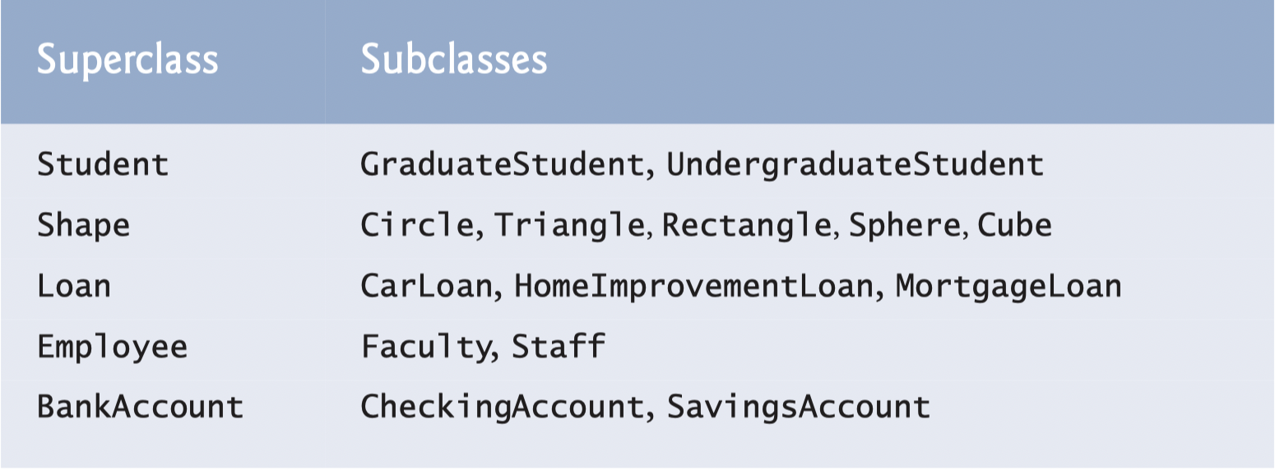
Examples of Inheritance
In C++, we call them base class and derived class.

Slide 6
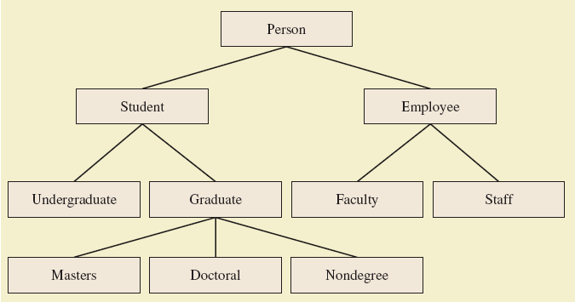
Derived Classes
Figure 8.1 A class hierarchy

Slide 7

Derived Classes
Class Person used as a base class
Also called superclass
Now we declare derived class Student
Also called subclass
Inherits methods from the superclass
View derived class, listing 8.2 class Student extends Person
View demo program, listing 8.3 class InheritanceDemo
Sample screen output

Slide 8
Overriding Method Definitions
Note method writeOutput in class Student
Class Person also has method with that name
Method in subclass with same signature overrides method from base class
Overriding method is the one used for objects of the derived class
Overriding method must return same type of value

Slide 9
Overriding Versus Overloading
Do not confuse overriding with overloading
Overriding takes place in subclass – new method with same signature
Overloading
New method in same class with different signature

Slide 10
The final Modifier
Possible to specify that a method cannot be overridden in subclass
Add modifier final to the heading public final void specialMethod()
An entire class may be declared final
Thus cannot be used as a base class to derive any other class

Slide 11
Private Instance Variables, Methods
Consider private instance variable in a base class
It is not inherited in subclass
It can be manipulated only by public accessor, modifier methods
Similarly, private methods in a superclass not inherited by subclass

Slide 12
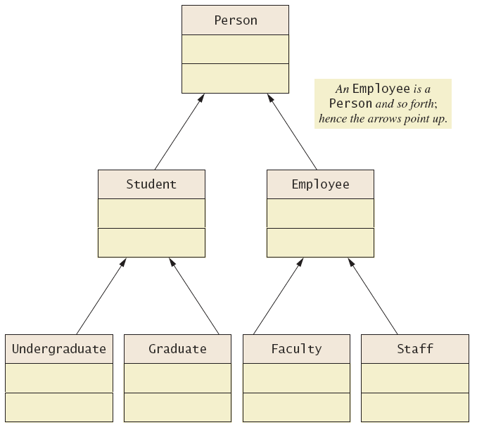
UML Inheritance Diagrams
Figure 8.2 A class hierarchy in UML notation

Slide 13
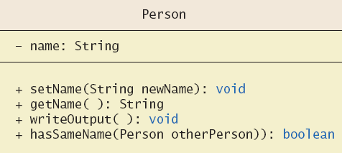
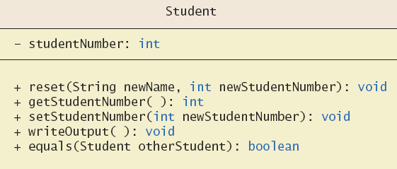
UML Inheritance Diagrams
Figure 8.3 Some details of UML class hierarchy from figure 8.2

Slide 14
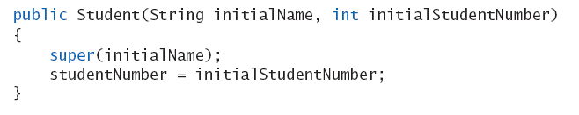
Constructors in Derived Classes
A derived class does not inherit constructors from base class
Constructor in a subclass must invoke constructor from base class
Use the reserve word super
Must be first action in the constructor

Slide 15

The this Method – Again
Also possible to use the this keyword
Use to call any constructor in the class
When used in a constructor, this calls constructor in same class
Contrast use of super which invokes constructor of base class

Slide 16
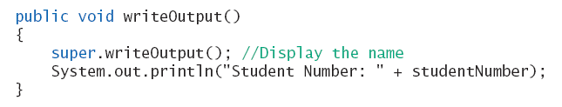
Calling an Overridden Method
Reserved word super can also be used to call method in overridden method
Calls method by same name in base class

Slide 17
Programming Example
A derived class of a derived class
View sample class, listing 8.4 class Undergraduate
Has all public members of both
Person
Student
This reuses the code in superclasses

Slide 18
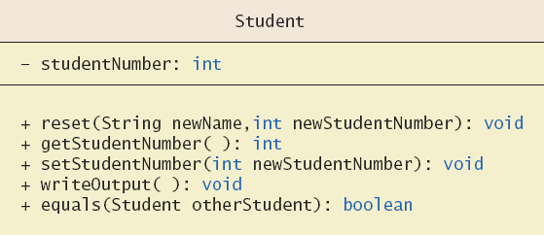
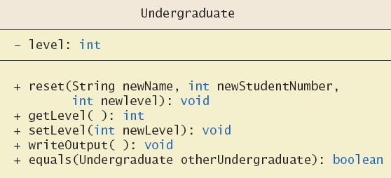
Programming Example
Figure 8.4 More details of the UML class hierarchy

Slide 19
Type Compatibility
In the class hierarchy
Each Undergraduate is also a Student
Each Student is also a Person
An object of a derived class can serve as an object of the base class
Note this is not typecasting
An object of a class can be referenced by a variable of an ancestor type

Slide 20
Type Compatibility
Be aware of the "is-a" relationship
A Student is a Person
Another relationship is the "has-a"
A class can contain (as an instance variable) an object of another type
If we specify a date of birth variable for Person – it "has-a" Date object

Slide 21
The Class Object
Java has a class that is the ultimate ancestor of every class
The class Object
Thus possible to write a method with parameter of type Object
Actual parameter in the call can be object of any type
Example: method println(Object theObject)

Slide 22
The Class Object
Class Object has some methods that every Java class inherits
Examples
Method equals
Method toString
Method toString called when println(theObject) invoked
Best to define your own toString to handle this

Slide 23
A Better equals Method
Programmer of a class should override method equals from Object
View code of sample override, listing 8.8 public boolean equals (Object theObject)

Slide 24
Polymorphism
Inheritance allows you to define a base class and derive classes from the base class
Polymorphism allows you to make changes in the method definition for the derived classes and have those changes apply to methods written in the base class

Slide 25
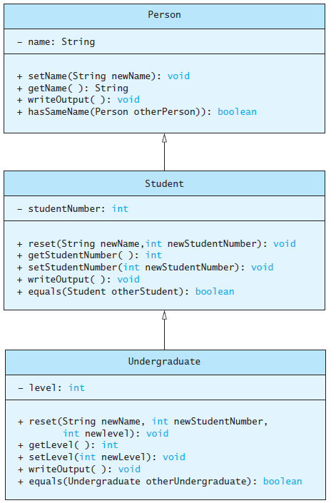
Polymorphism
Consider an array of Person
Person[] people = new Person[4];
Since Student and Undergraduate are types of Person, we can assign them to Person variables
people[0] = new Student("DeBanque, Robin", 8812);
people[1] = new Undergraduate("Cotty, Manny", 8812, 1);

Slide 26
Polymorphism
Given:
Person[] people = new Person[4];
people[0] = new Student("DeBanque, Robin", 8812);
When invoking:
people[0].writeOutput();
Which writeOutput() is invoked, the one defined for Student or the one defined for Person?
Answer: The one defined for Student

Slide 27
An Inheritance as a Type
The method can substitute one object for another
Called polymorphism
This is made possible by mechanism
Dynamic binding
Also known as late binding

Slide 28
Dynamic Binding and Inheritance
When an overridden method invoked
Action matches method defined in class used to create object using new
Not determined by type of variable naming the object
Variable of any ancestor class can reference object of descendant class
Object always remembers which method actions to use for each method name

Slide 29
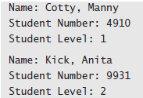
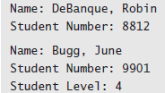
Polymorphism Example
View sample class, listing 8.6 class PolymorphismDemo
Output

Slide 30
Class Interfaces
Consider a set of behaviors for pets
Be named
Eat
Respond to a command
We could specify method headings for these behaviors
These method headings can form a class interface

Slide 31
Class Interfaces
Now consider different classes that implement this interface
They will each have the same behaviors
Nature of the behaviors will be different
Each of the classes implements the behaviors/methods differently

Slide 32
Java Interfaces
A program component that contains headings for a number of public methods
Will include comments that describe the methods
Interface can also define public named constants
View example interface, listing 8.7 interface Measurable

Slide 33
Java Interfaces
Interface name begins with uppercase letter
Stored in a file with suffix .java
Interface does not include
Declarations of constructors
Instance variables
Method bodies

Slide 34
Implementing an Interface
To implement a method, a class must
Include the phrase implements Interface_name
Define each specified method
View sample class, listing 8.8 class Rectangle implements Measurable
View another class, listing 8.9 which also implements Measurable class Circle

Slide 35
An Inheritance as a Type
Possible to write a method that has a parameter as an interface type
An interface is a reference type
Program invokes the method passing it an object of any class which implements that interface

Slide 36
Extending an Interface
Possible to define a new interface which builds on an existing interface
It is said to extend the existing interface
A class that implements the new interface must implement all the methods of both interfaces

Slide 37
Case Study
Character Graphics
View interface for simple shapes, listing 8.10 interface ShapeInterface
If we wish to create classes that draw rectangles and triangles
We could create interfaces that extend ShapeInterface
View interfaces, listing 8.11

Slide 38
Case Study
Now view base class, listing 8.12 which uses (implements) previous interfaces class ShapeBasics
Note
Method drawAt calls drawHere
Derived classes must override drawHere
Modifier extends comes before implements

Slide 39
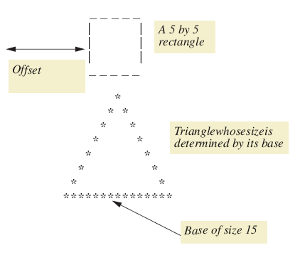
Case Study
Figure 8.5 A sample rectangle and triangle

Slide 40
Case Study
Note algorithm used by method drawHere to draw a rectangle
Draw the top line
Draw the side lines
Draw the bottom lines
Subtasks of drawHere are realized as private methods
View class definition, listing 8.13 class Rectangle

Slide 41
Case Study
View next class to be defined (and tested), listing 8.14 class Triangle
It is a good practice to test the classes as we go
View demo program, listing 8.15 class TreeDemo

Slide 42
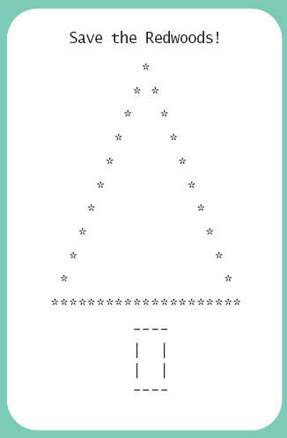
Case Study
Sample screen output

Slide 43
Case Study The Comparable Interface
Java has many predefined interfaces
One of them, the Comparable interface, is used to impose an ordering upon the objects that implement it
Requires that the method compareTo be written
public int compareTo(Object other);

Slide 44
Sorting an Array of Fruit Objects
Initial (non-working) attempt to sort an array of Fruit objects
View class definition, listing 8.16 class Fruit
View test class, listing 8.17 class FruitDemo
Result: Exception in thread “main”
Sort tries to invoke compareTo method but it doesn’t exist

Slide 45
Sorting an Array of Fruit Objects
Working attempt to sort an array of Fruit objects – implement Comparable, write compareTo method
View class definition, listing 8.18 class Fruit
Result: Exception in thread “main”
Sort tries to invoke method but it doesn’t exist

Slide 46
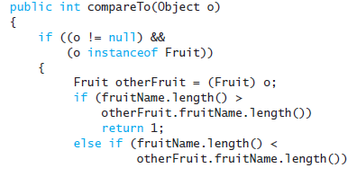
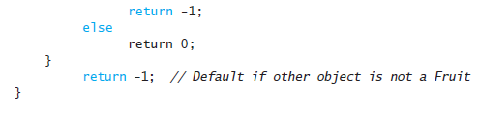
compareTo Method
An alternate definition that will sort by length of the fruit name

Slide 47
Abstract Classes
Class ShapeBasics is designed to be a base class for other classes
Method drawHere will be redefined for each subclass
It should be declared abstract – a method that has no body
This makes the class abstract
You cannot create an object of an abstract class – thus its role as base class

Slide 48
Abstract Classes
Not all methods of an abstract class are abstract methods
Abstract class makes it easier to define a base class
Specifies the obligation of designer to override the abstract methods for each subclass

Slide 49
Abstract Classes
Cannot have an instance of an abstract class
But OK to have a parameter of that type
View abstract version, listing 8.19 abstract class ShapeBase

Slide 50
Dynamic Binding and Inheritance
Note how drawAt (in ShapeBasics) makes a call to drawHere
Class Rectangle overrides method drawHere
How does drawAt know where to find the correct drawHere?
Happens with dynamic or late binding
Address of correct code to be executed determined at run time

Slide 51
Graphics Supplement: Outline
Event-Driven Programming
Separate class to handle events
Anonymous inner class
Same class as the window

Slide 52
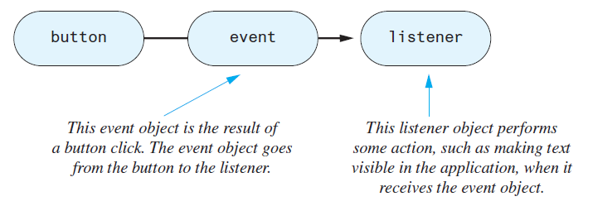
Event Firing and Event Listeners
An event object is generated when something happens, like a button is clicked, the mouse is moved, the mouse is over a component, the mouse leaves a component, etc.
You specify what happens when the event occurs by creating an event handler or listener

Slide 53
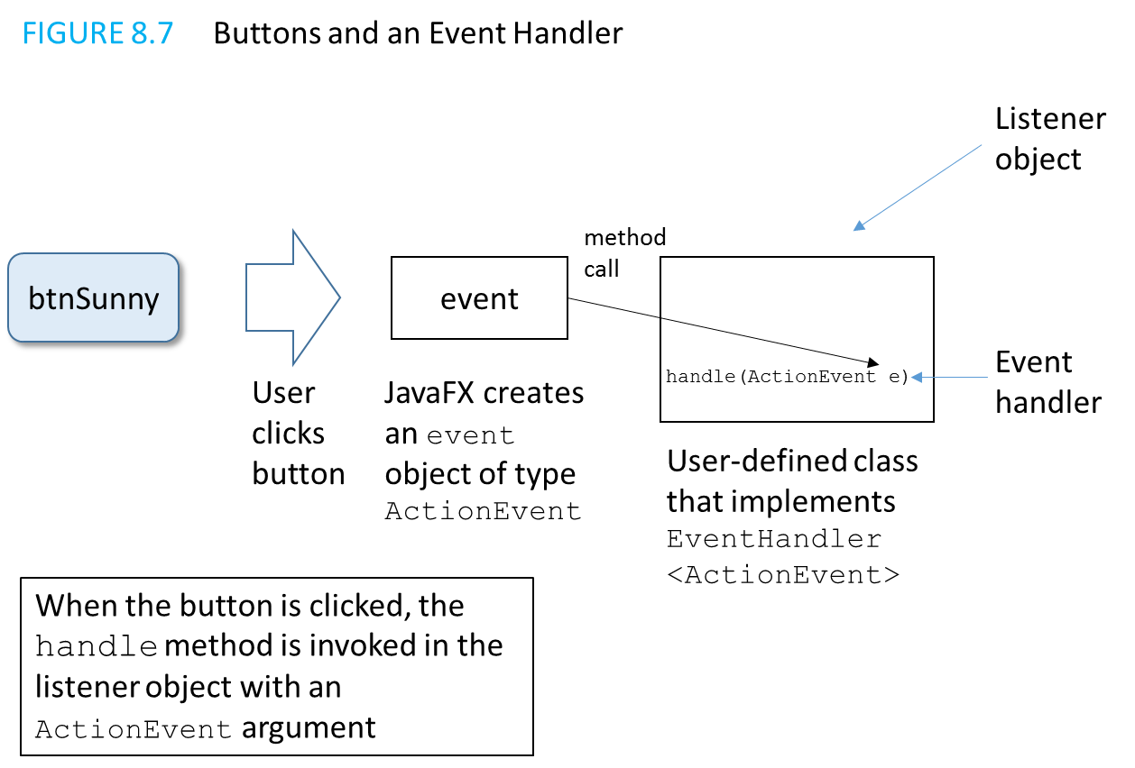
An Event Handler for a Button Click
You write the handle method! It is invoked via polymorphism

Slide 54
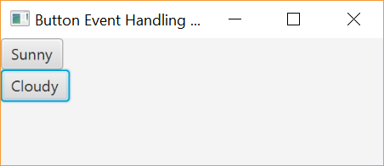
Event Handling with a Separate Class
We can write a class whose purpose is specifically to handle a particular event, in this case, to react to a button click
View event handling demo 1, listing 8.20, ButtonDemo1
and event handler, listing 8.21, HandleButtonClick
The program outputs “It is sunny!” to the console when the “Sunny” button is clicked, and “It is cloudy.” When the “Cloudy” button is clicked.

Slide 55
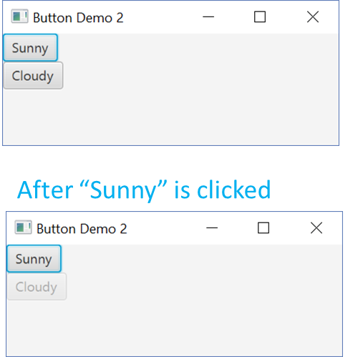
Event Handling in the Main GUI Class
We can put the event handler in the same class as the GUI; this allows the event handler to have easy access to any GUI class variables
Add the handler and implement the ActionListener
View event handling demo 2, listing 8.22, ButtonDemo2

Slide 56
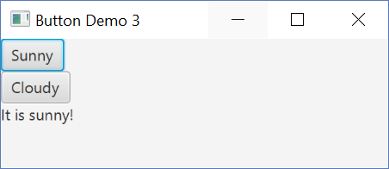
Event Handling in an Anonymous Inner Class
We can create a new event handler by creating an anonymous inner class for each event we want to handle
This is a class with no name that we declare and instantiate at the same time
View event handling demo 3, listing 8.23, ButtonDemo3
(After clicking “Sunny”)

Slide 57
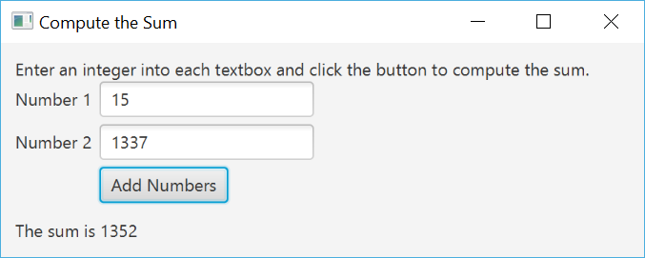
Event Handling Example – Adding Numbers
An example that ties together layouts (GridPane with BorderPane) and event handling to add two numbers together is shown in AddingNumbersApp
View event handling demo 4, listing 8.24, AddingNumbersApp

Slide 58
Summary
An interface contains
Headings of public methods
Definitions of named constants
No constructors, no private instance variables
Class which implements an interface must
Define a body for every interface method specified
Interface enables designer to specify methods for another programmer

Slide 59
Summary
Interface is a reference type
Can be used as variable or parameter type
Interface can be extended to create another interface
Dynamic (late) binding enables objects of different classes to substitute for one another
Must have identical interfaces
Called polymorphism

Slide 60
Summary
Derived class obtained from base class by adding instance variables and methods
Derived class inherits all public elements of base class
Constructor of derived class must first call a constructor of base class
If not explicitly called, Java automatically calls default constructor

Slide 61
Summary
Within constructor
this calls constructor of same class
super invokes constructor of base class
Method from base class can be overridden
Must have same signature
If signature is different, method is overloaded

Slide 62
Summary
Overridden method can be called with preface of super
Private elements of base class cannot be accessed directly by name in derived class
Object of derived class has type of both base and derived classes
Legal to assign object of derived class to variable of any ancestor type

Slide 63
Summary
Every class is descendant of class Object
JavaFX uses interfaces to implement listeners for events like button clicks
The event listener can be implemented as its own class, part of the GUI class, or as an anonymous inner class

